Slide 1
FinWise
Tailored Solutions, Intelligent Insights, Your Money, Your Way!
Focus Area
We aim to integrate all aspects of financial planning to ensure each aspect helps other aspects rather than hinder. The system crafts personalized investment strategies, budgeting plans, and financial advice to optimize each user's unique financial situation.
CodeCrafters
Abhinand I | Backend Developer
Minhaj P | Database & Back end
Niranjan | Front end & Model building

Slide 2
Relevancy and Business Opportunity
The system is relevant as it addresses the contemporary need for personalized, adaptable, and comprehensive financial management, empowering users to navigate their financial journeys with confidence and efficiency. The proposed financial platform presents several business opportunities that can be explored and capitalized upon. The most prominent of them being forging partnerships with banks, investment firms, or other financial institutions to integrate their services into the platform. This collaboration could lead to revenue-sharing agreements and provide users with a seamless experience for managing their accounts.

Slide 3
Idea/Approach Details
Technology Stack
Continuous monitoring and adaptive recommendations for informed financial decisions
Personalized investment strategies based on user's financial goals and current income
Comprehensive financial planning tool with intelligent budgeting and savings features
The tech stack includes a cloud-based backend using Python, Django, HTML/CSS for the frontend, TensorFlow or PyTorch for machine learning, and robust security measures with OAuth for user authentication. API integration ensures smooth communication, while CI/CD pipelines handle updates efficiently.

Slide 4
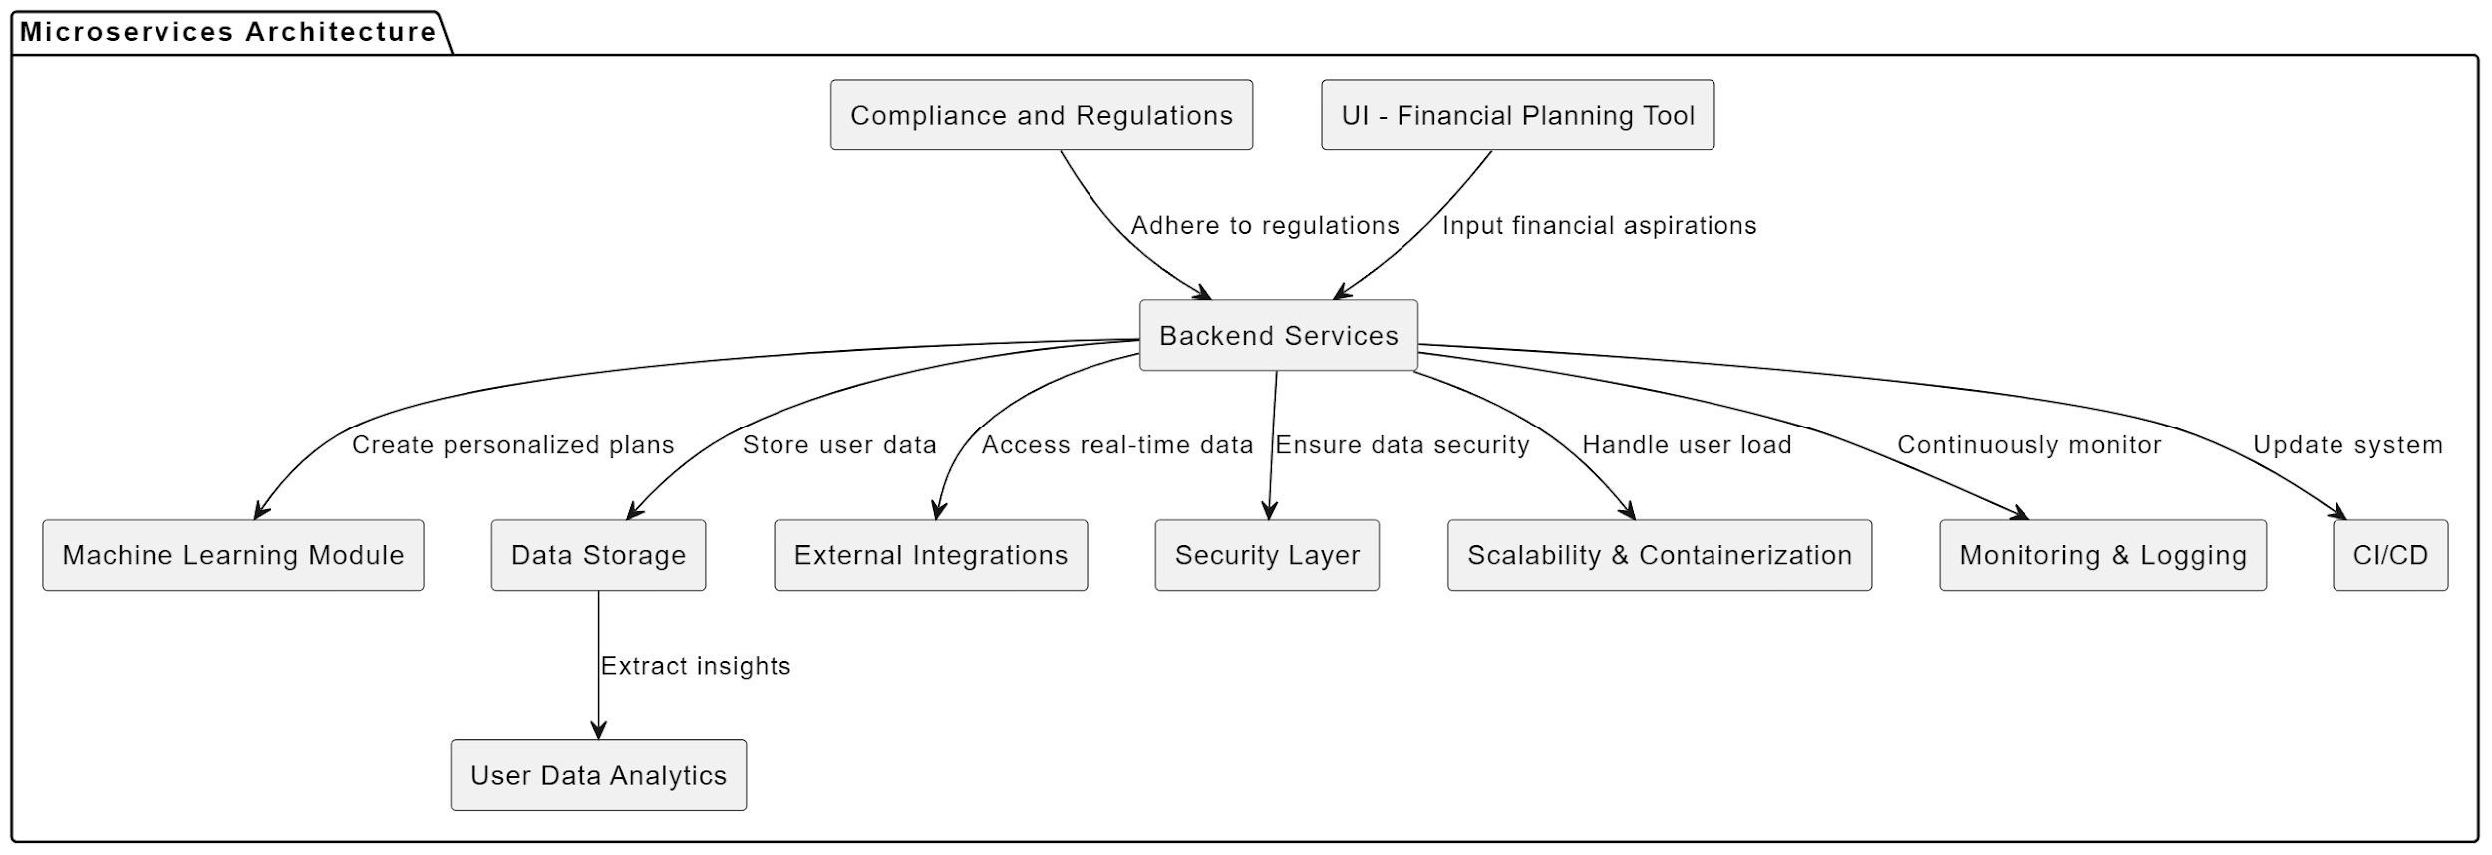
Software Architecture

Slide 5
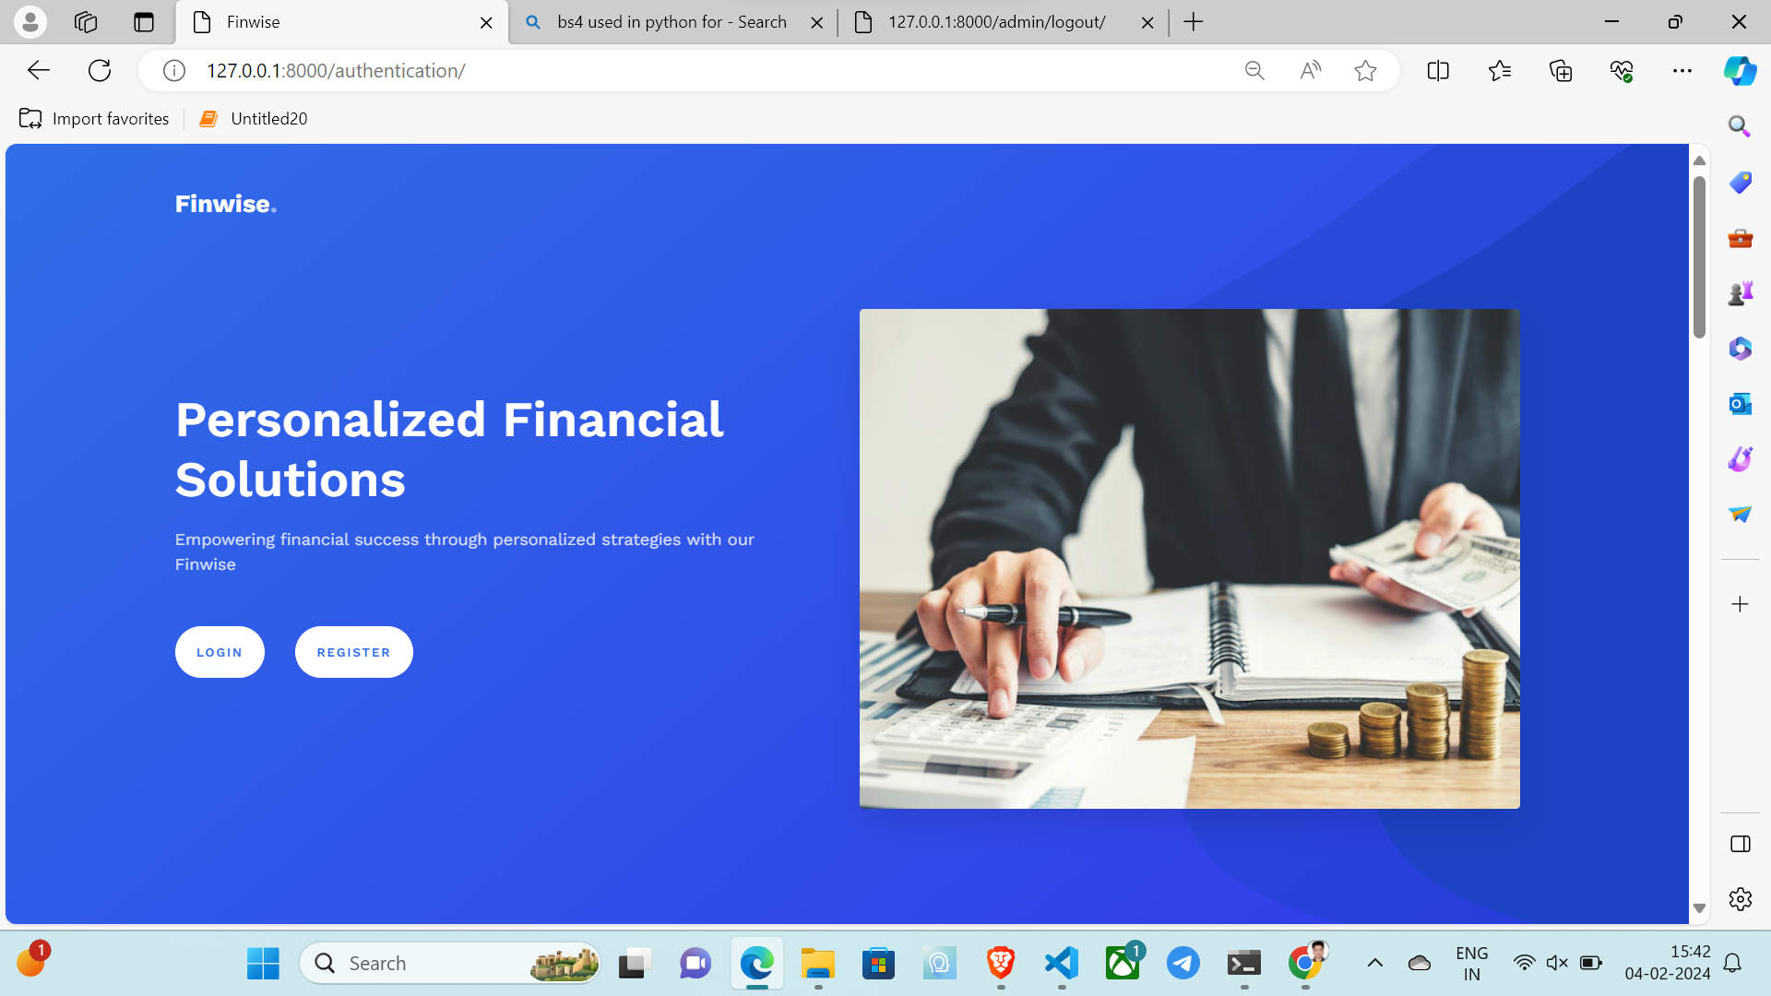
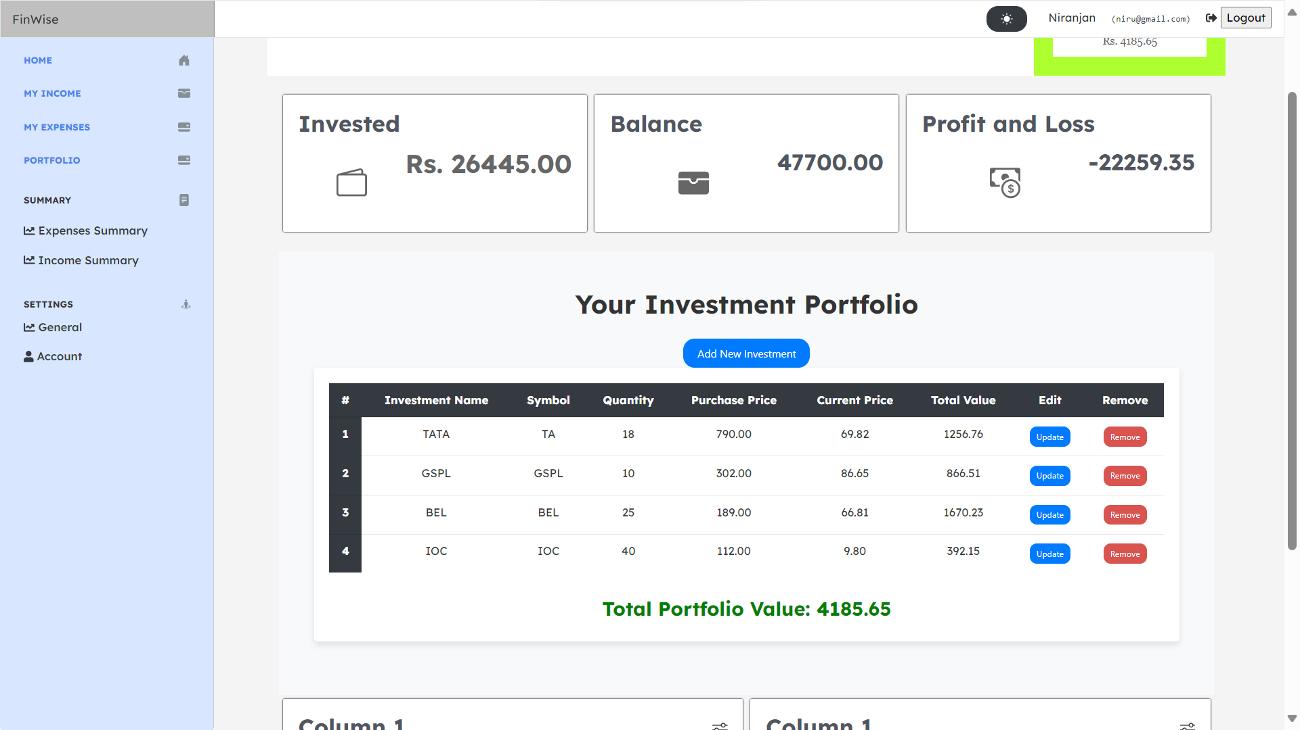
UI

